Slide 1
Politician Rating App

Slide 2
?
?
Election Campaigns
?
Surveys and Polls
Indian Elections
Advertisements
?
?
Lots of News
?
Rumours
Undeterministic Voting

Slide 3
Why rating politicians?
More claims, less work
Buying of votes, of poor section of society
False claims and promises
No awareness of societal problems at root level
Winning under image of their party/leader
Blaming others for their work, rather than putting efforts themselves

Slide 4
How to rate politicians?
Investigating on the work done by the politician
Determining how many of the claims appear to be true
What is his public liking and image?
Discussing with family and friends before voting
Seeing the public liking towards his/her work

Slide 5
How to investigate and discuss?
One way is face to face, but that’s difficult in today’s digital world
Other way is to follow up electronic media like news channels & print media.
One rising media with powerful widespread technology and huge impact on public debate is social media.
These social network sites have the potential for increasing political participation.
Provide freedom of speech and easy communication.

Slide 6





Social Media plays a crucial role for sharing public opinions

Slide 7
Twitter is the major platform used for sharing political opinions.
One of important microblogging site receiving around 500 million tweets every day.
Every Political Party and political leader has a twitter handle.
All youths participate well on this platform.
Also reaches wide Audience.
Can easily guess which political leader is upraised much by public, by seeing factors like likes and retweets.

Slide 8

What if you can’t find time for scrolling through the feeds?
Sentimental Analysis
Determines the public opinion
through NLP(Natural Language Processing).

Slide 9
Objective
Help a common user to easily get a public opinion of a politician based on their recent news feed
Saving the valuable time of user, which was earlier killed by scrolling through the politician’s original feeds and analysing them individually
Design an app for easy interaction and analysis

Slide 10



Project Division
Backend
Running algorithm for sentimental analysis
Frontend
Designing UI using Android
Bridge
AWS (Amazon Web Servies)

Slide 11
Sentimental Analysis
Naïve Bayes Classifier
Recurrent Neural Network
A simple algorithm which categorises tweets into positive / negative / neutral.
Extracts feature vectors from training set and based on those vectors, analyses the input.
Eg : Ram is good at volleyball . (good is taken as positive feature)
It rained badly today. (badly is taken as negative feature)
A complex algorithm based on LSTM architecture
RNN understands each words based on the understanding of previous word
Eg : Even though it rained badly, the yield was good
RNN remembers the context before , and then analyses the other statement.

Slide 12
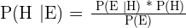
Naïve Bayes Classifier
Based on Bayes Theoram
Works on conditional probability
where,
P(H) is the probability of hypothesis H being true. This is known as the prior probability.
P(E) is the probability of the evidence(regardless of the hypothesis).
P(E|H) is the probability of the evidence given that hypothesis is true.
P(H|E) is the probability of the hypothesis given that the evidence is there.

Slide 13
Advantages
Works a lot faster
Since it works on independent predictions, for some cases, it holds good
Easy to implement
Disadvantages
Assumption of independent predictors produce less accurate results in many cases
If a new categorical feature is found in test dataset, it assigns 0 probability to the feature and is unable to make a prediction

Slide 14
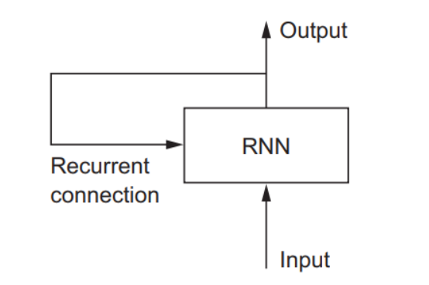
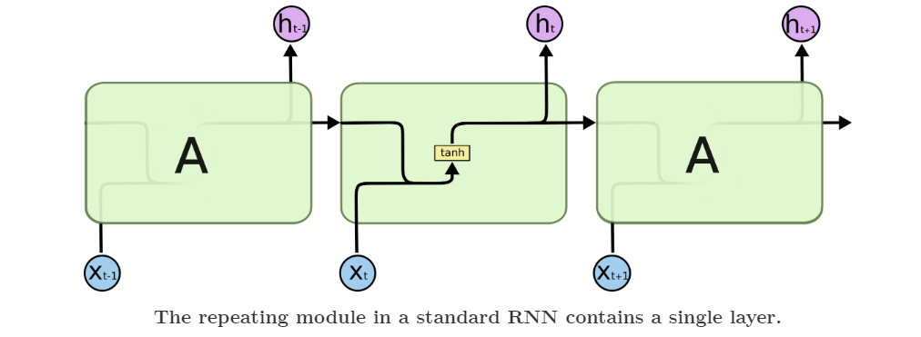
Recurrent Neural Network
RNNs can learn to use the past information.
But if the nodes increase, the information usually fades away
Repeating module has a tanh structure

Slide 15
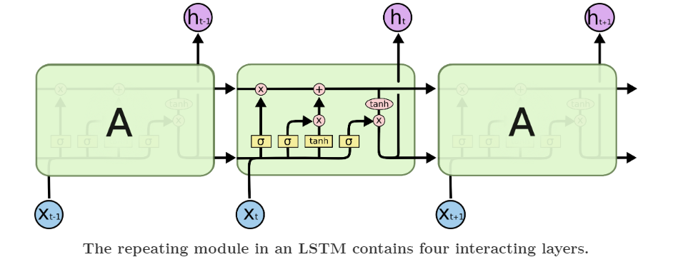
Long Short Term Memory
Special kind of RNN, capable of learning long-term dependencies.
Remember information for long periods of time easily
Repeating module has a different structure, with 4 different neural network layers

Slide 16
Advantages
Easily remembers previous context through long term memory
Hence more accurate results
Disadvantages
Sometimes it faces vanishing gradient problem, which is a drawback of RNN
Because of complex functions involved, it takes more time
Difficult to implement

Slide 17

Why Android Frontend ?
An app that makes the task of analysing politicians easy.
Easy comparisons and interactive charts available for analysing.
Attractive and user-friendly UI.
Faster Response Time.
Text based analysis is done.
Minimum Android Version – Android 6.0 Marshmallow

Slide 18





Cloud Computing Platform (AWS)
Amazon Web Services offers reliable, scalable, and inexpensive cloud computing services.
Technolgies Used :
Lambda
Cognito
IAM
EC2
S3

Slide 19
System Design
Twitter Dataset
Android Front-End
Data Cleaning (Remove Special Characters, http links)
Authentication
Connected with AWS-SDK to run .py script
AWS Back-End
Apply sentiment Analysis, do chart Analysis
Dropdown connected with s3
Store results in s3
Call back to front-end
Read results from s3 and display
Android Front-End

Slide 20



AWS IAM
1
Amazon
Cognito
Identity
Pool
AWS Mobile SDK for Android
2
Cognito Identity
4
3
AWS Lambda
Execution Role
Using AWS IAM and Amazon Cognito,
fetch results from s3 Bucket
12
AWS EC2
13
Lambda Function
5
Using boto3, start instance
AWS Architecture
RSA
.ppk file
6
.pem file
8
AWS S3
7
Instance ID
Connect using SSH
9
Run .py script
s3 bucket
11
10
Store Results
Using AWS secret access key,upload to s3 bucket

Slide 21
Modules
Length vs Date
Likes vs Date
Retweets vs Date
Length vs No. of Tweets
Source of Tweets
Languages Used for Tweets
Chart Based Analysis
Based on:
Polarity (sentimental analysis)
Taxonomy
Emotions
Advance Analysis

Slide 22
Technical Specification
Anaconda Development Kit (For Backend Code)
Android Studio (For Frontend Code)
Firebase (For Authorization)
AWS (Amazon Web Services)
FileZilla and Putty Tool (For SSH Connections)

Slide 23
Milestones Achieved
Writing the backend code in python for producing final results in JSON format.
Creating a EC2 instance, which runs my backend code.
Creating a S3 bucket which gives read/write permissions to the output JSON files.
Creating a Lambda Function in order to invoke the EC2 server and run the code on it.
Creating the frontend in Android and connect to AWS using Cognito and IAM roles.
Fetching data from S3 and displaying final output in android app
A review paper under process for publication (IJITEE)

Slide 24
Project Constraints
Time Constraint - Because of the 2 algorithms involved and real-time fetcing of twitter data everytime, it takes between 1 -2 minutes to execute the code
Solution - To resolve it, I store the files everytime on the local storage of the phone, so that the user need not execute again and get the results in the future.
Space Constraint – To resolve time constraint, user needs to give storage access to the app on phone.

Slide 25
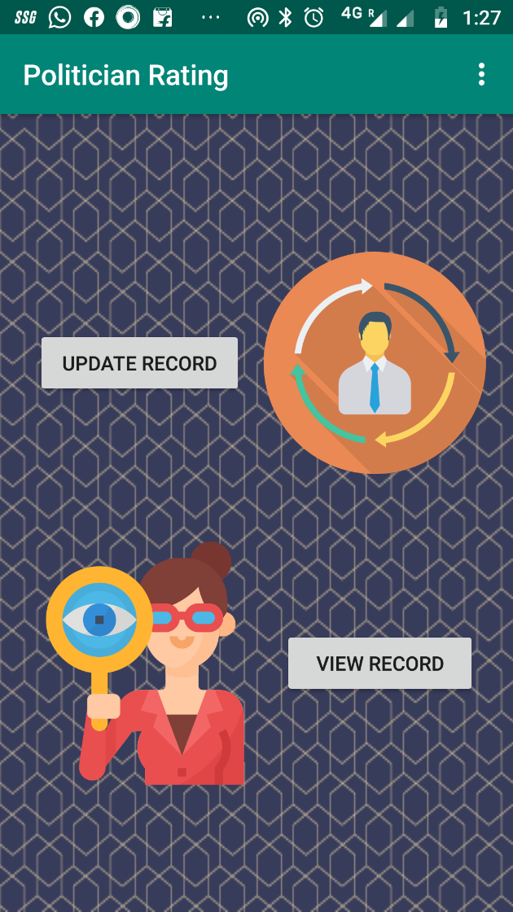
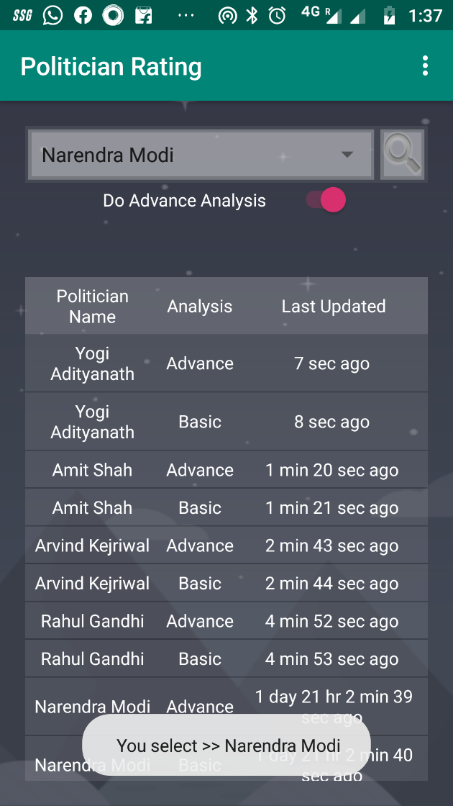
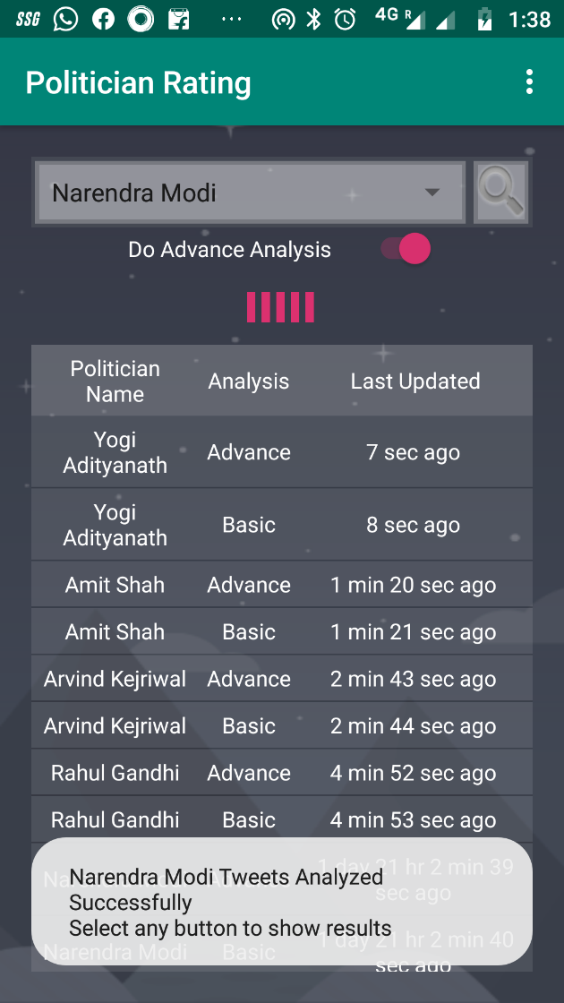
Sample Screenshots

Slide 26
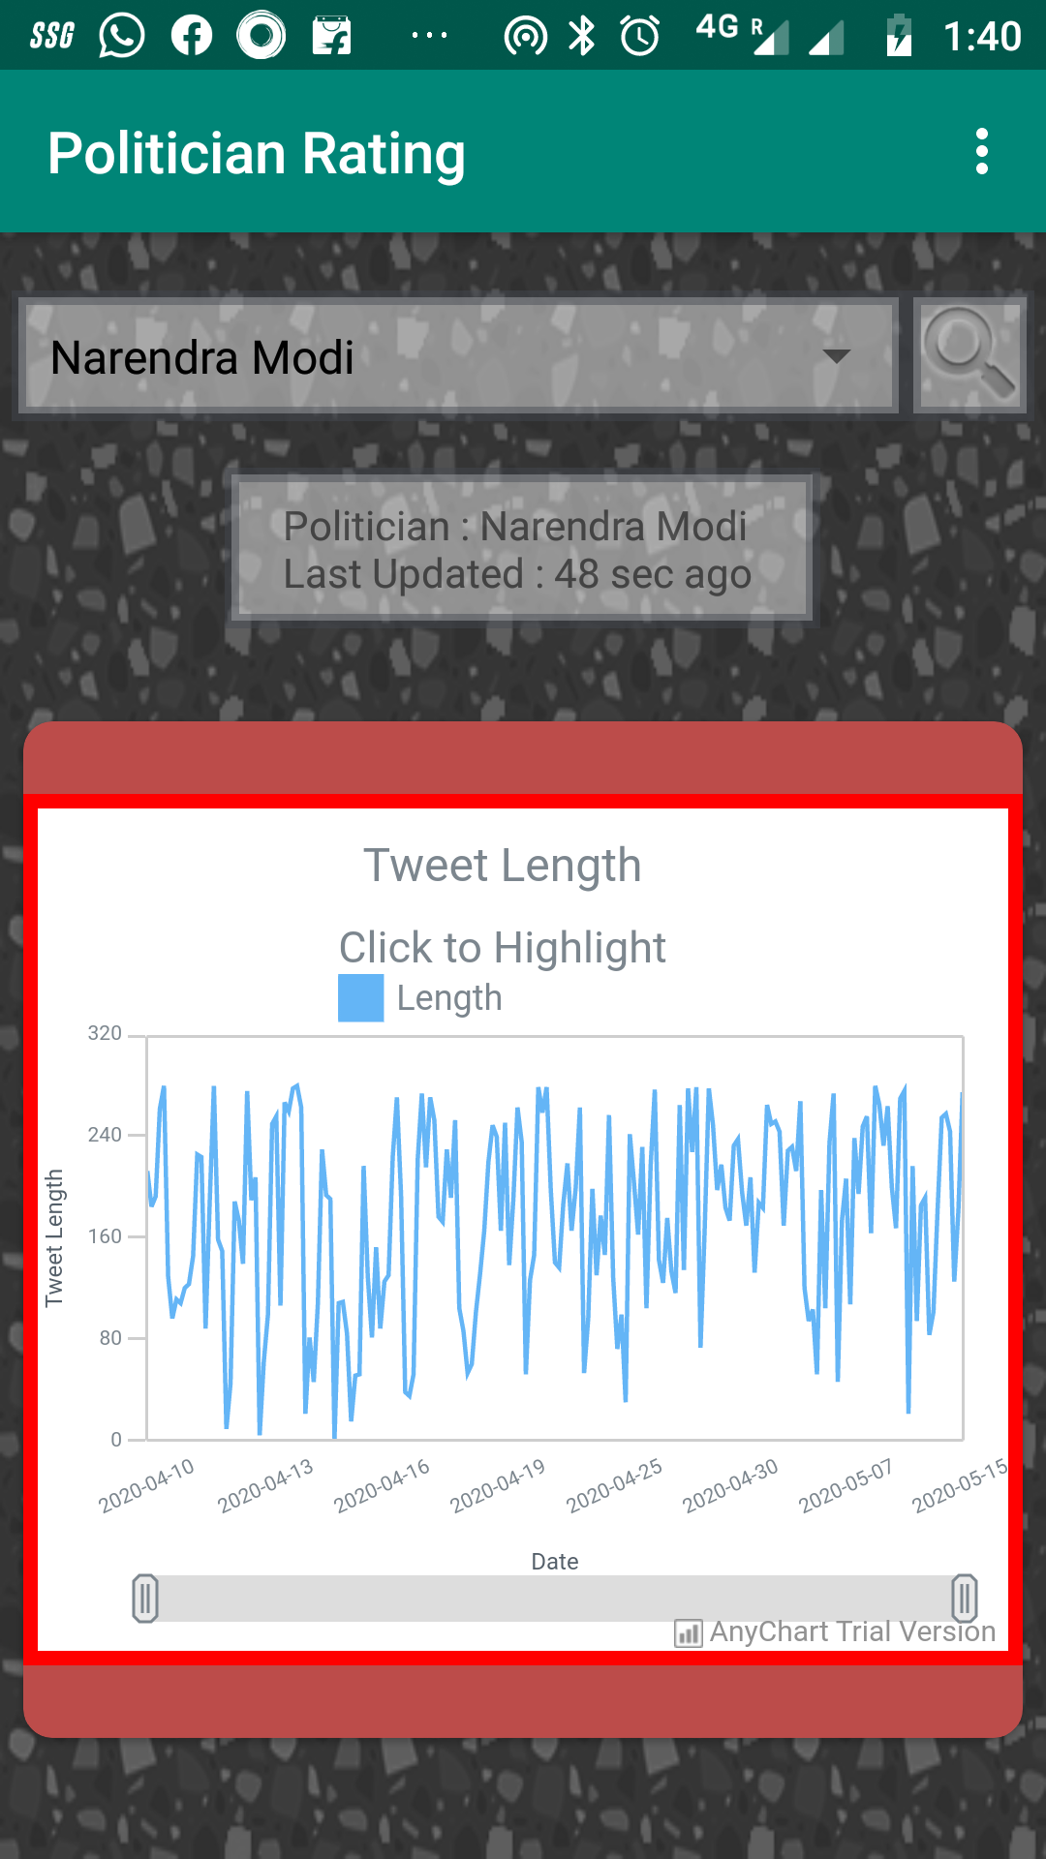
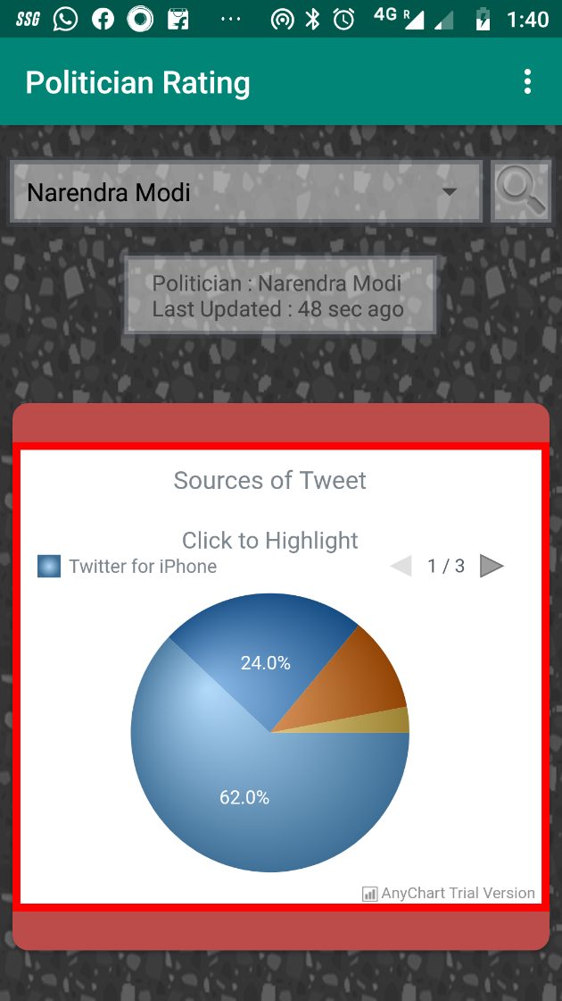
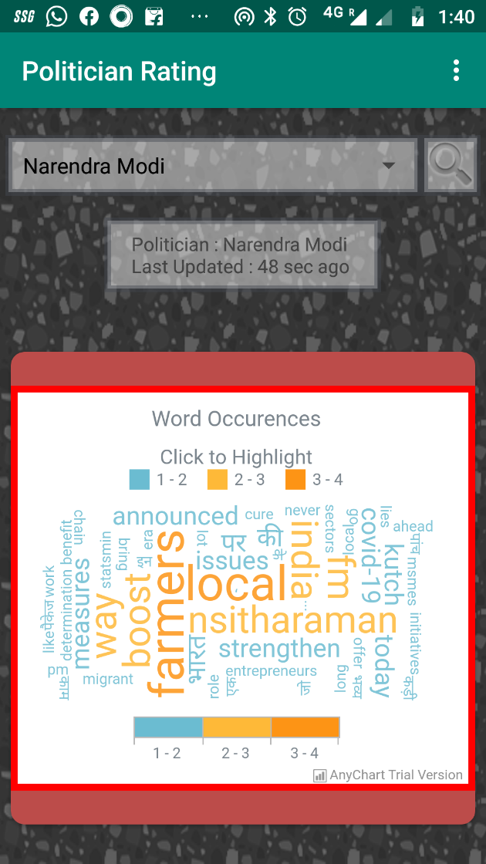
Sample Screenshots

Slide 27
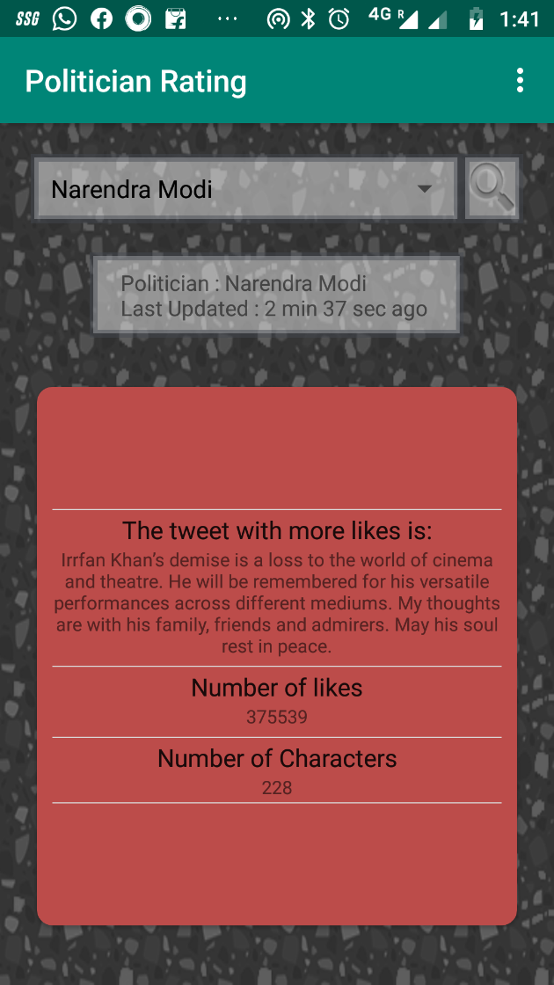
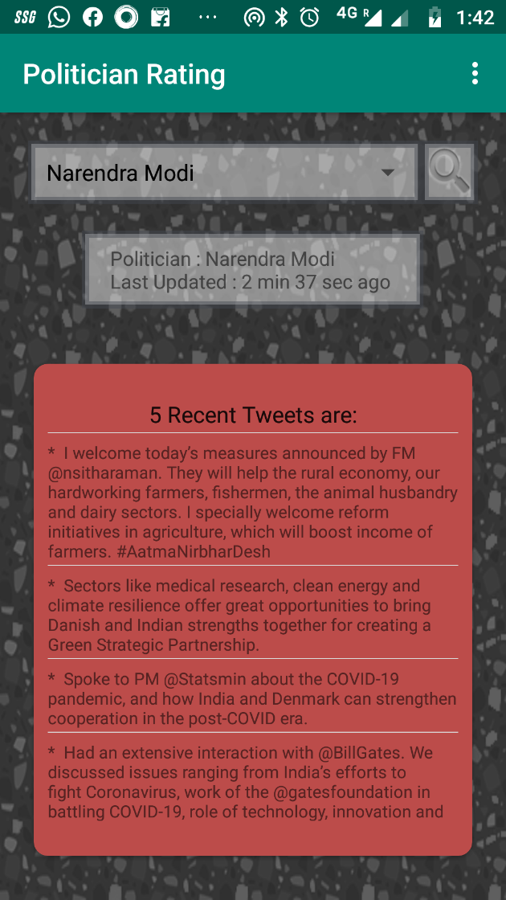
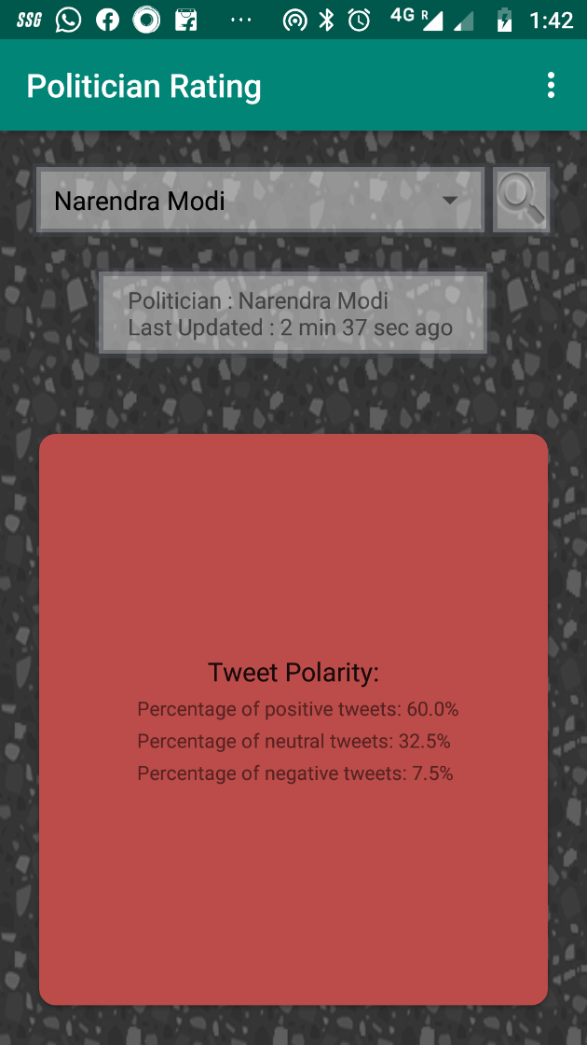
Sample Screenshots

Slide 28
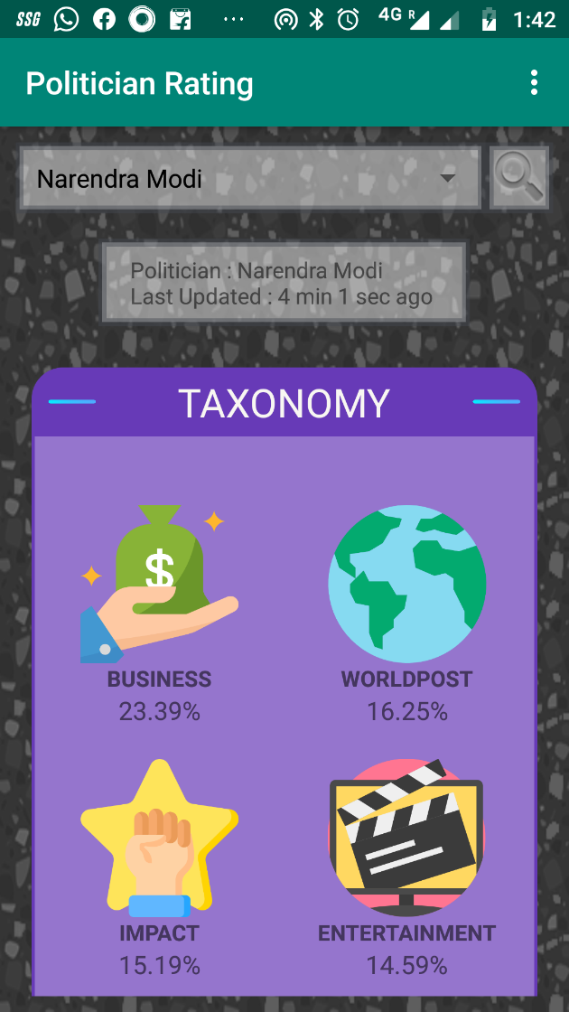
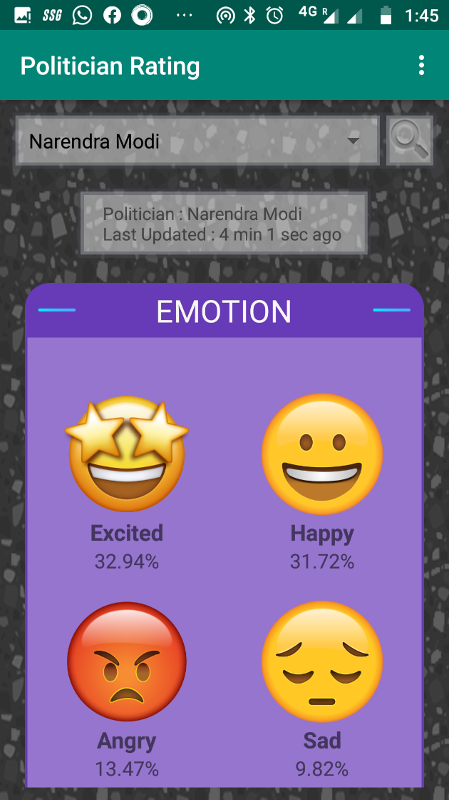
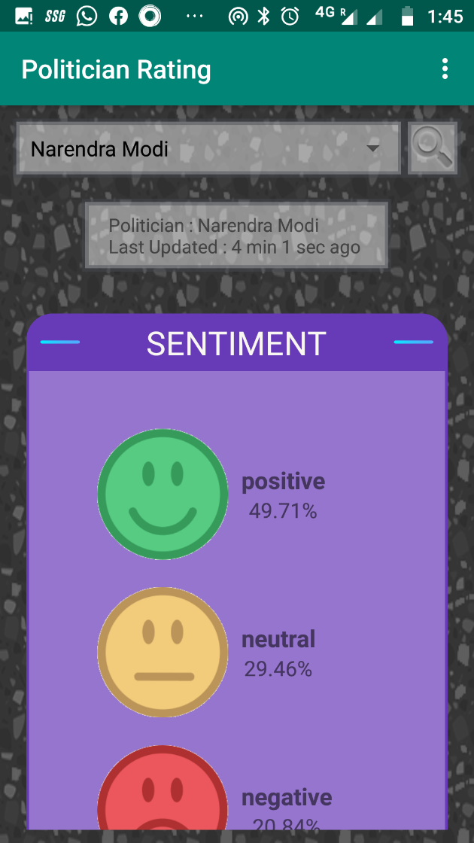
Sample Screenshots

Slide 29
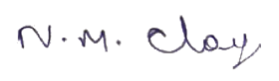
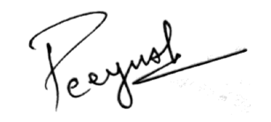
Signature of Guide
Signature of Student

Slide 30

Thank You

